Slide 1
Overview
Bioassay with novel species
LK952 Corynebacterium
LK960 Kocuria
LK1000 Kocuria
LK1337 Brevibacterium
23 pathogen panel (A. flavus came in too late)
6 biological replicates except for LK1337 (2 biological x 2 technical)

Slide 2
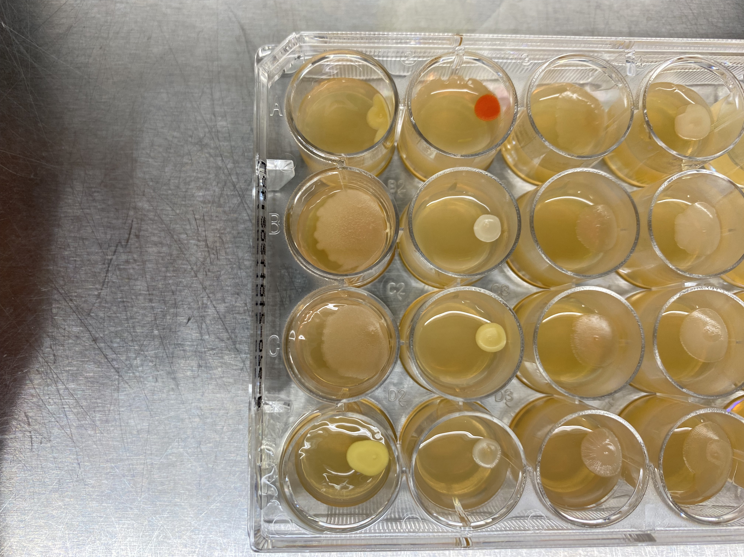
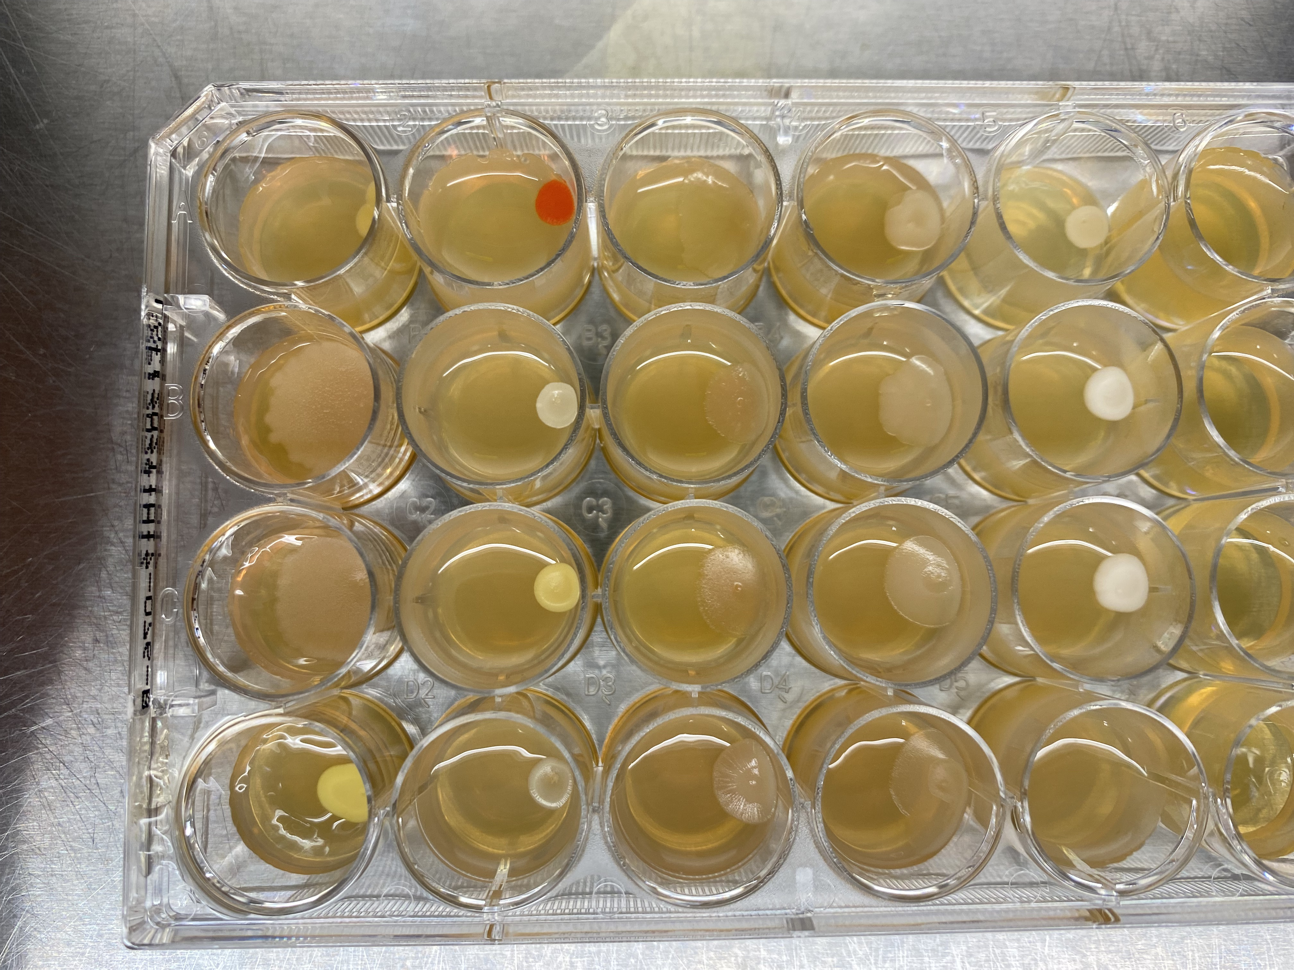
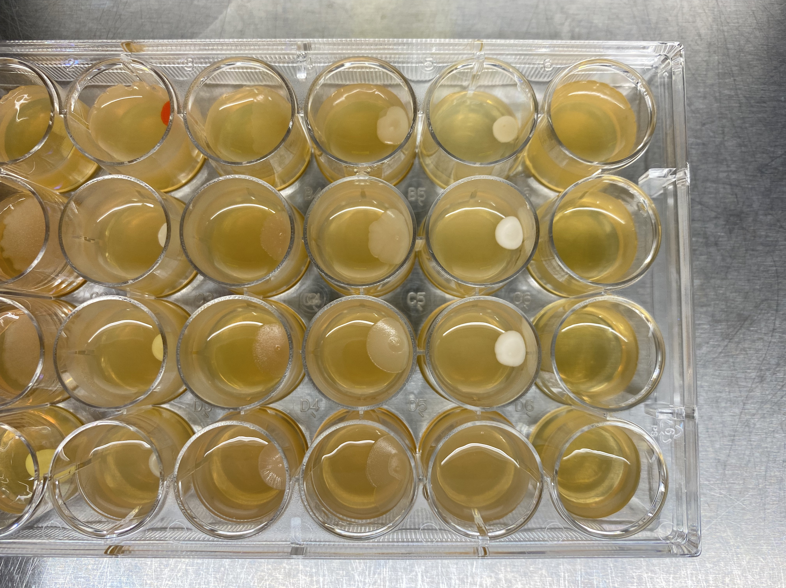
Pathogen control
Gram-negative
Fungi
Gram-positive

Slide 3
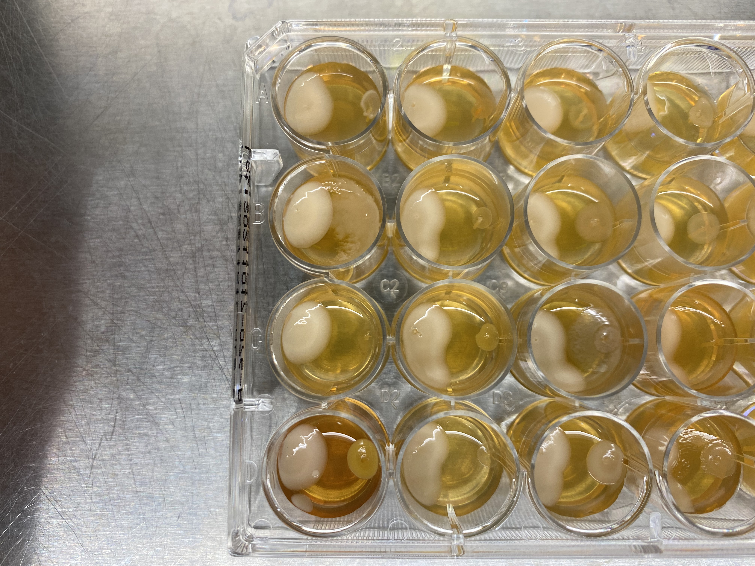
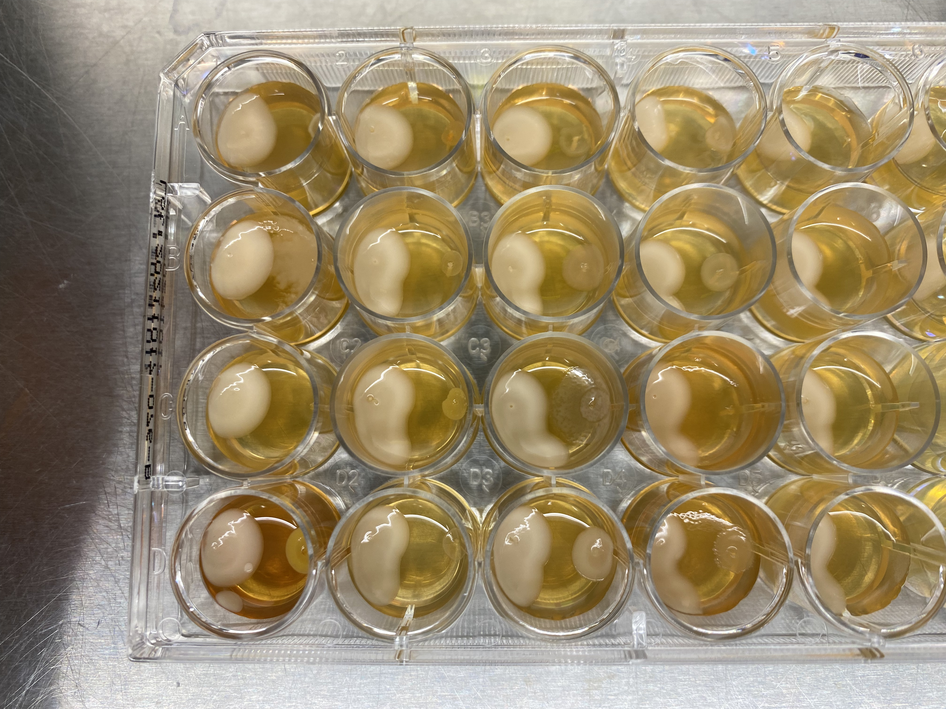
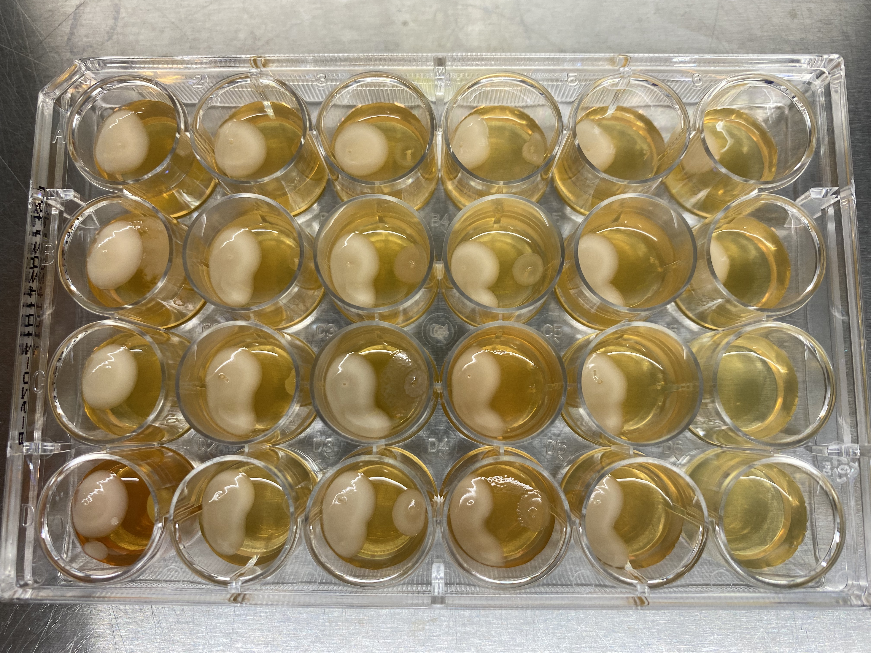
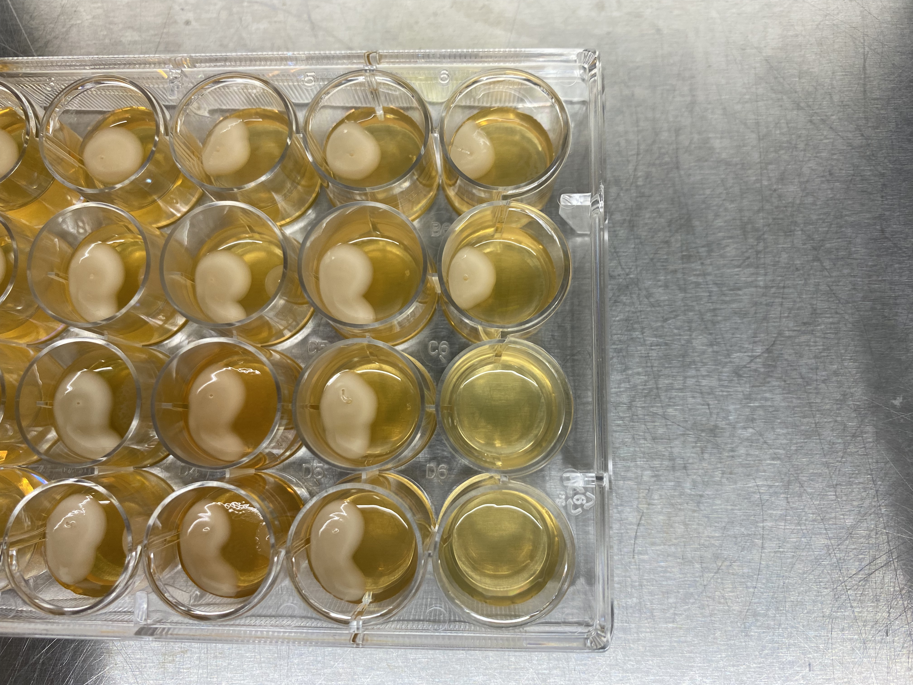
LK952
Gram-negative
Fungi
Gram-positive

Slide 4
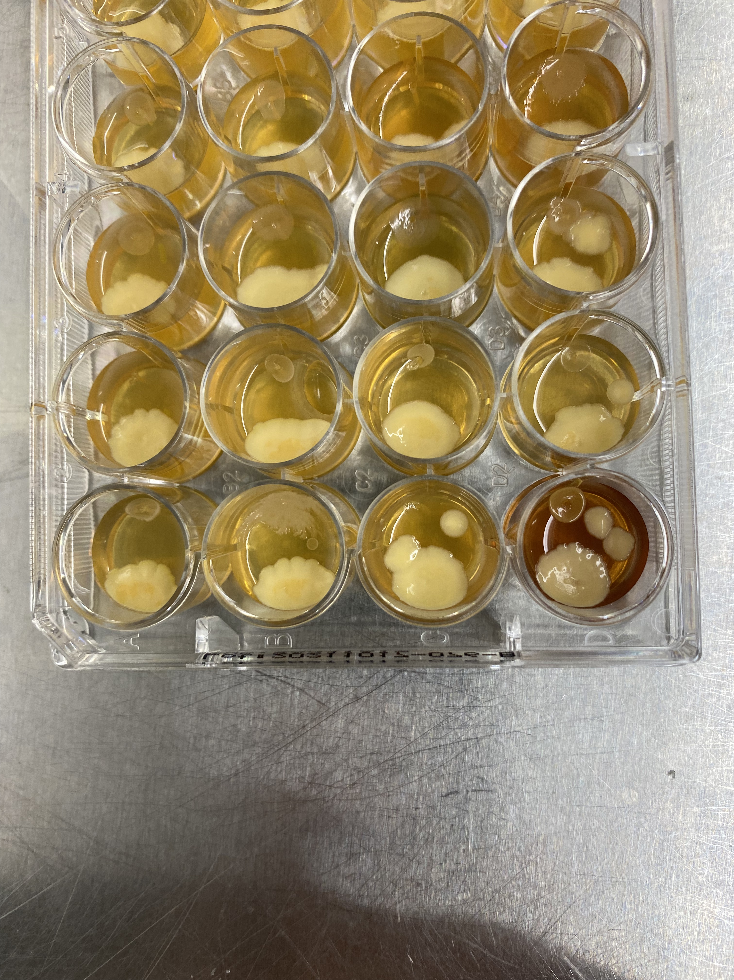
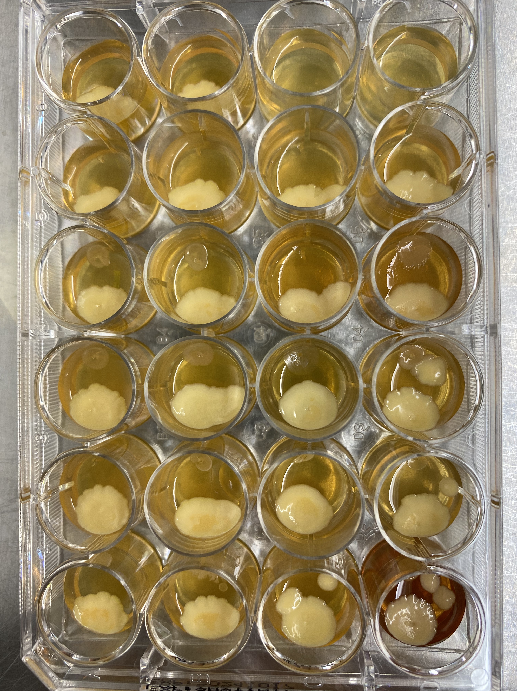
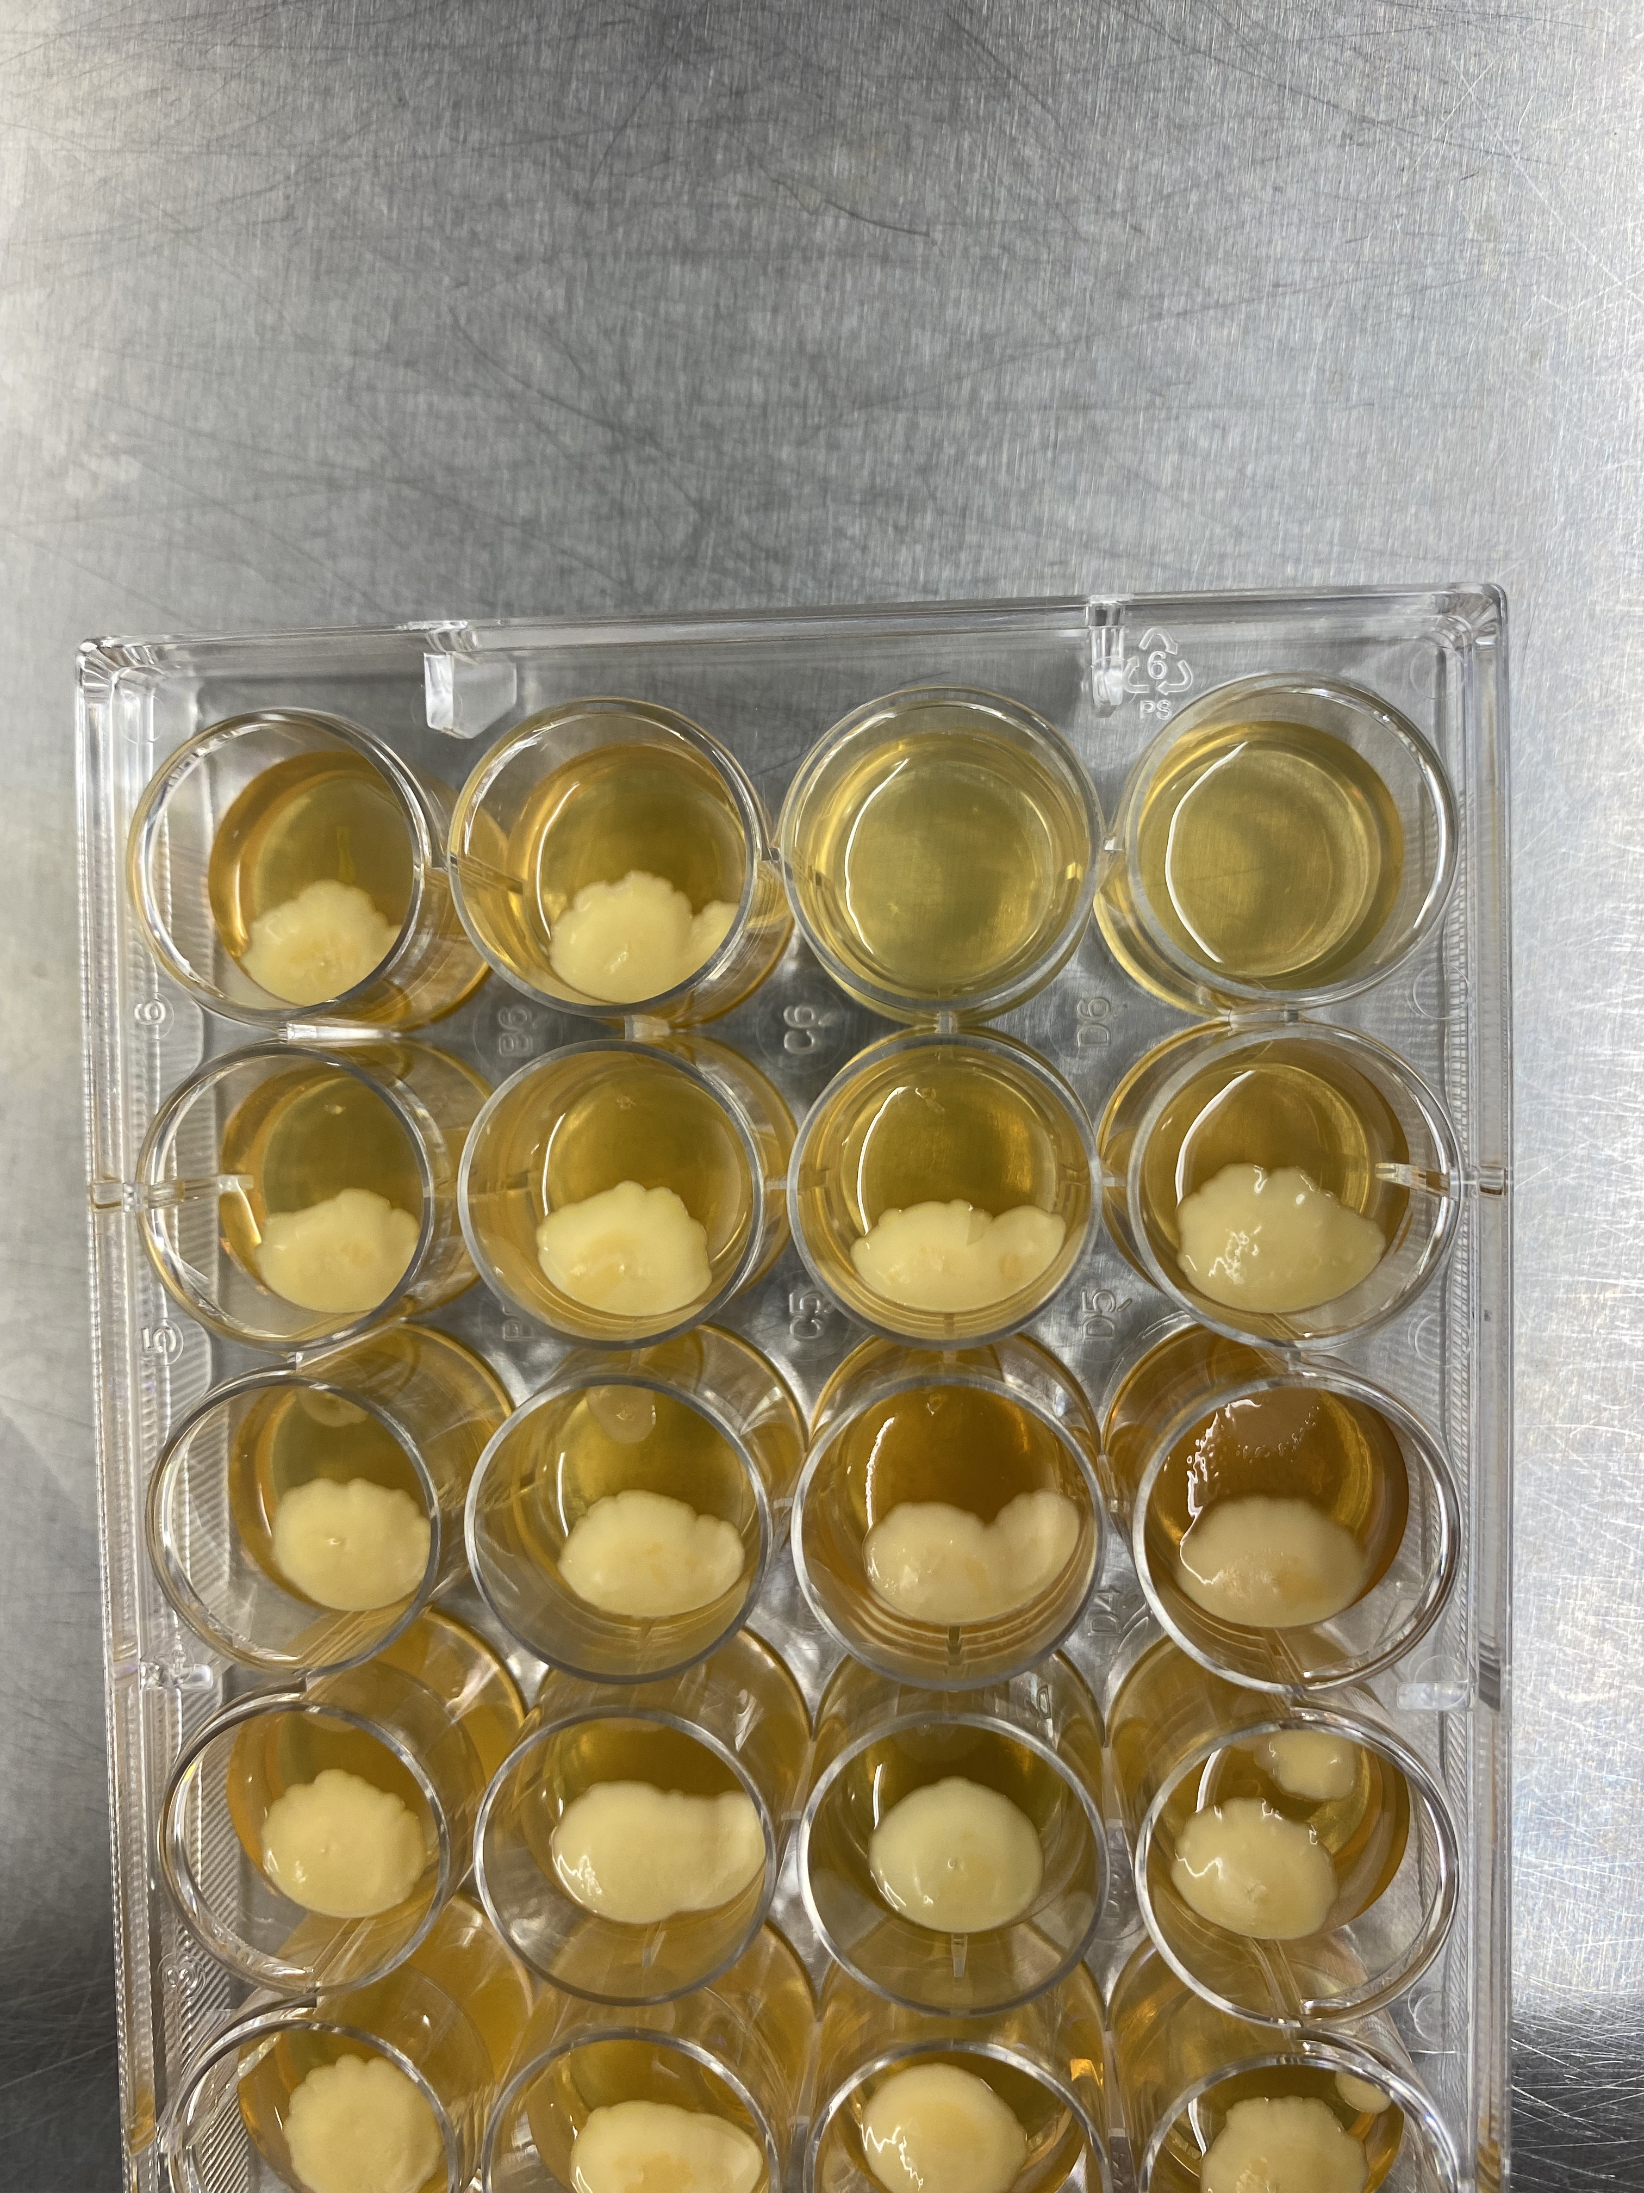
LK960
Gram-negative
Fungi
Gram-positive

Slide 5
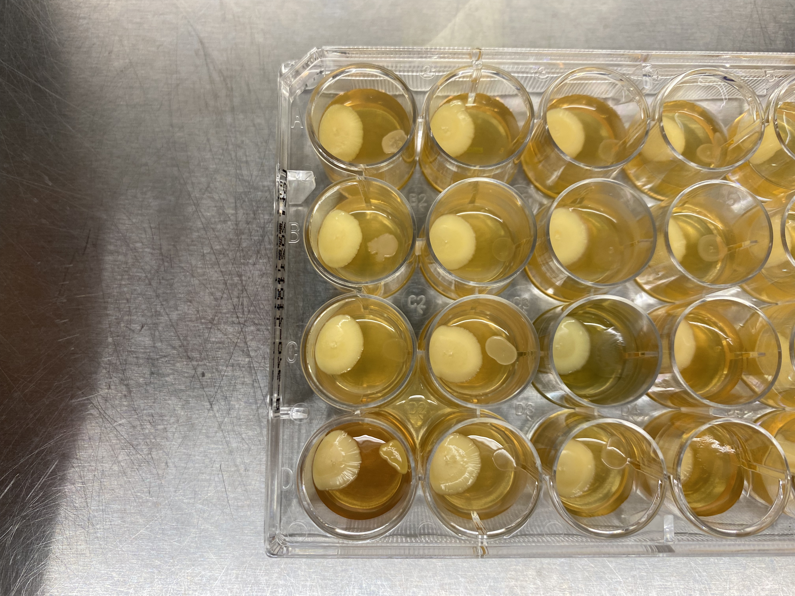
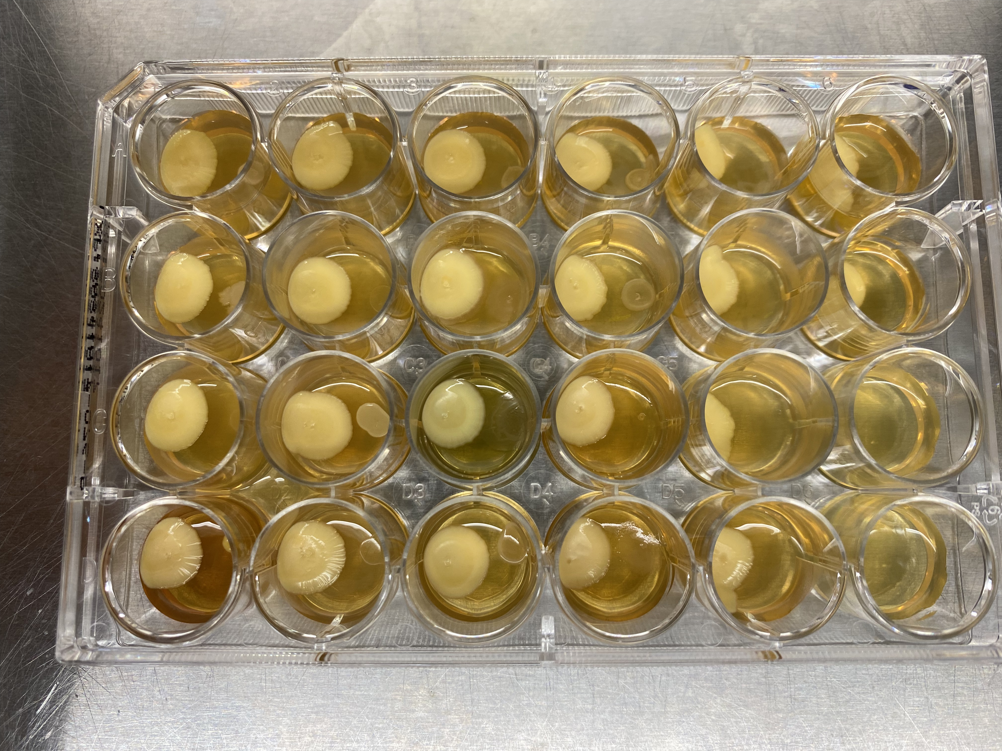
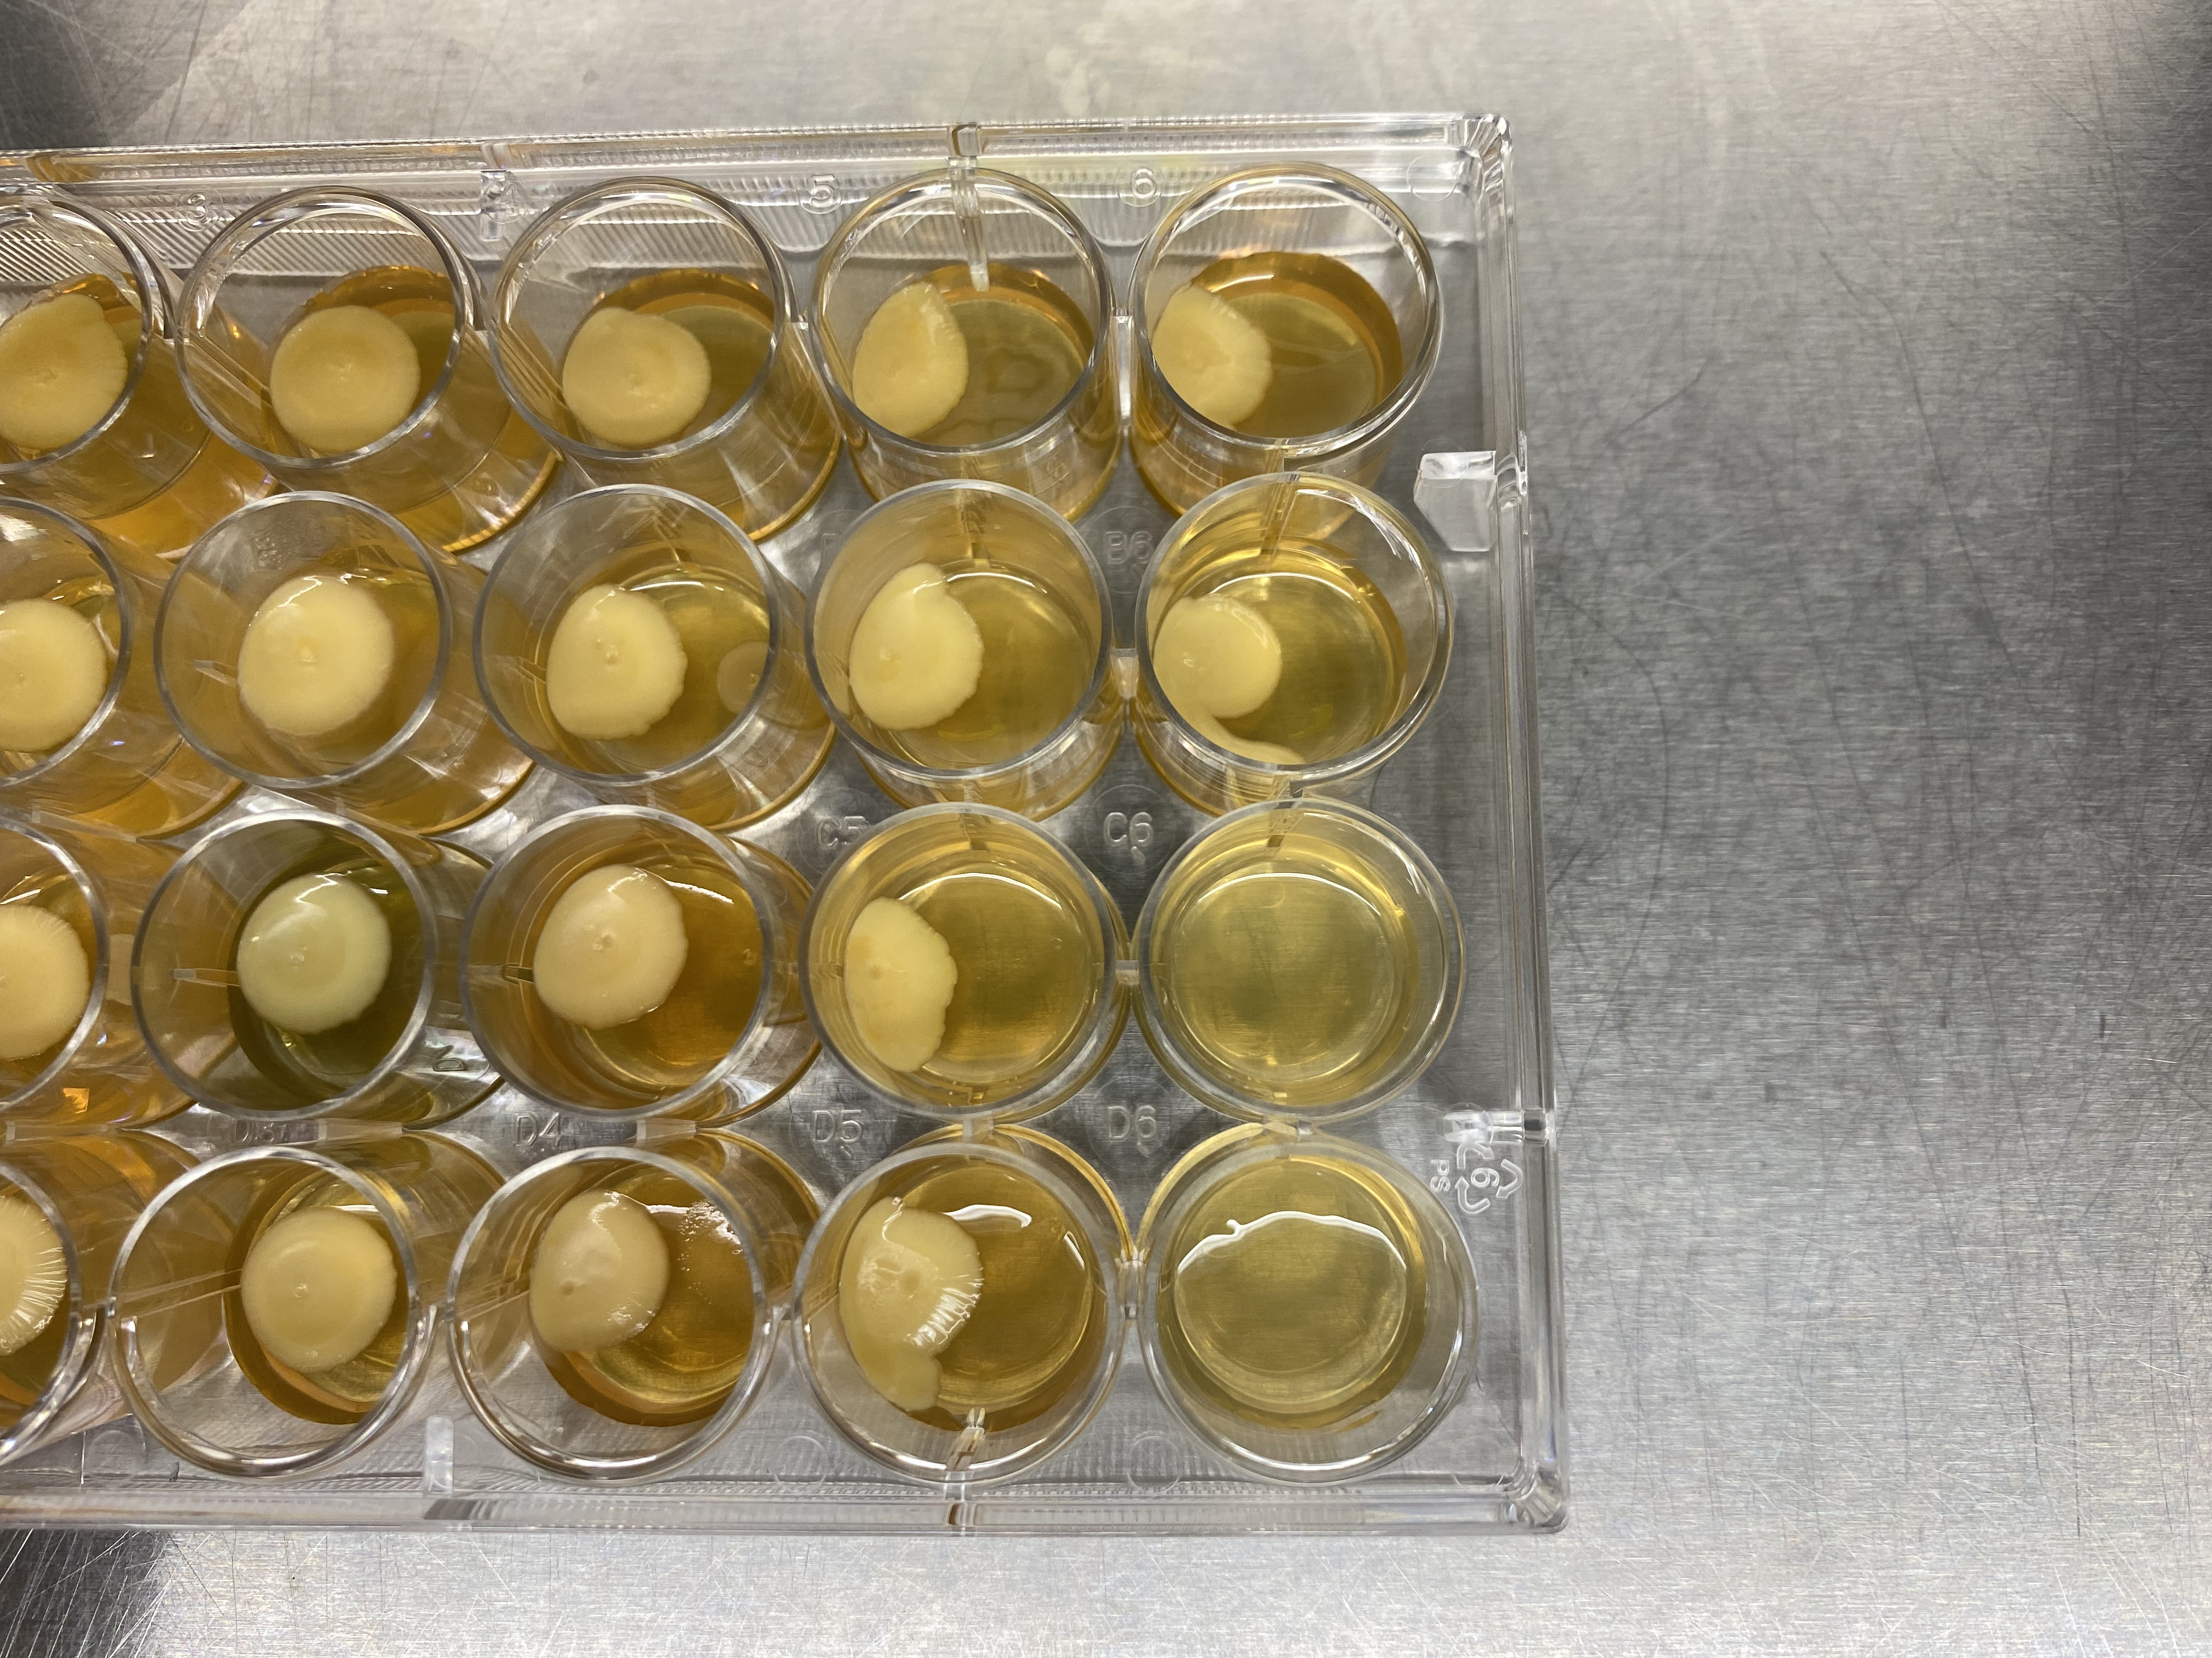
LK1000
Gram-negative
Fungi
Gram-positive

Slide 6
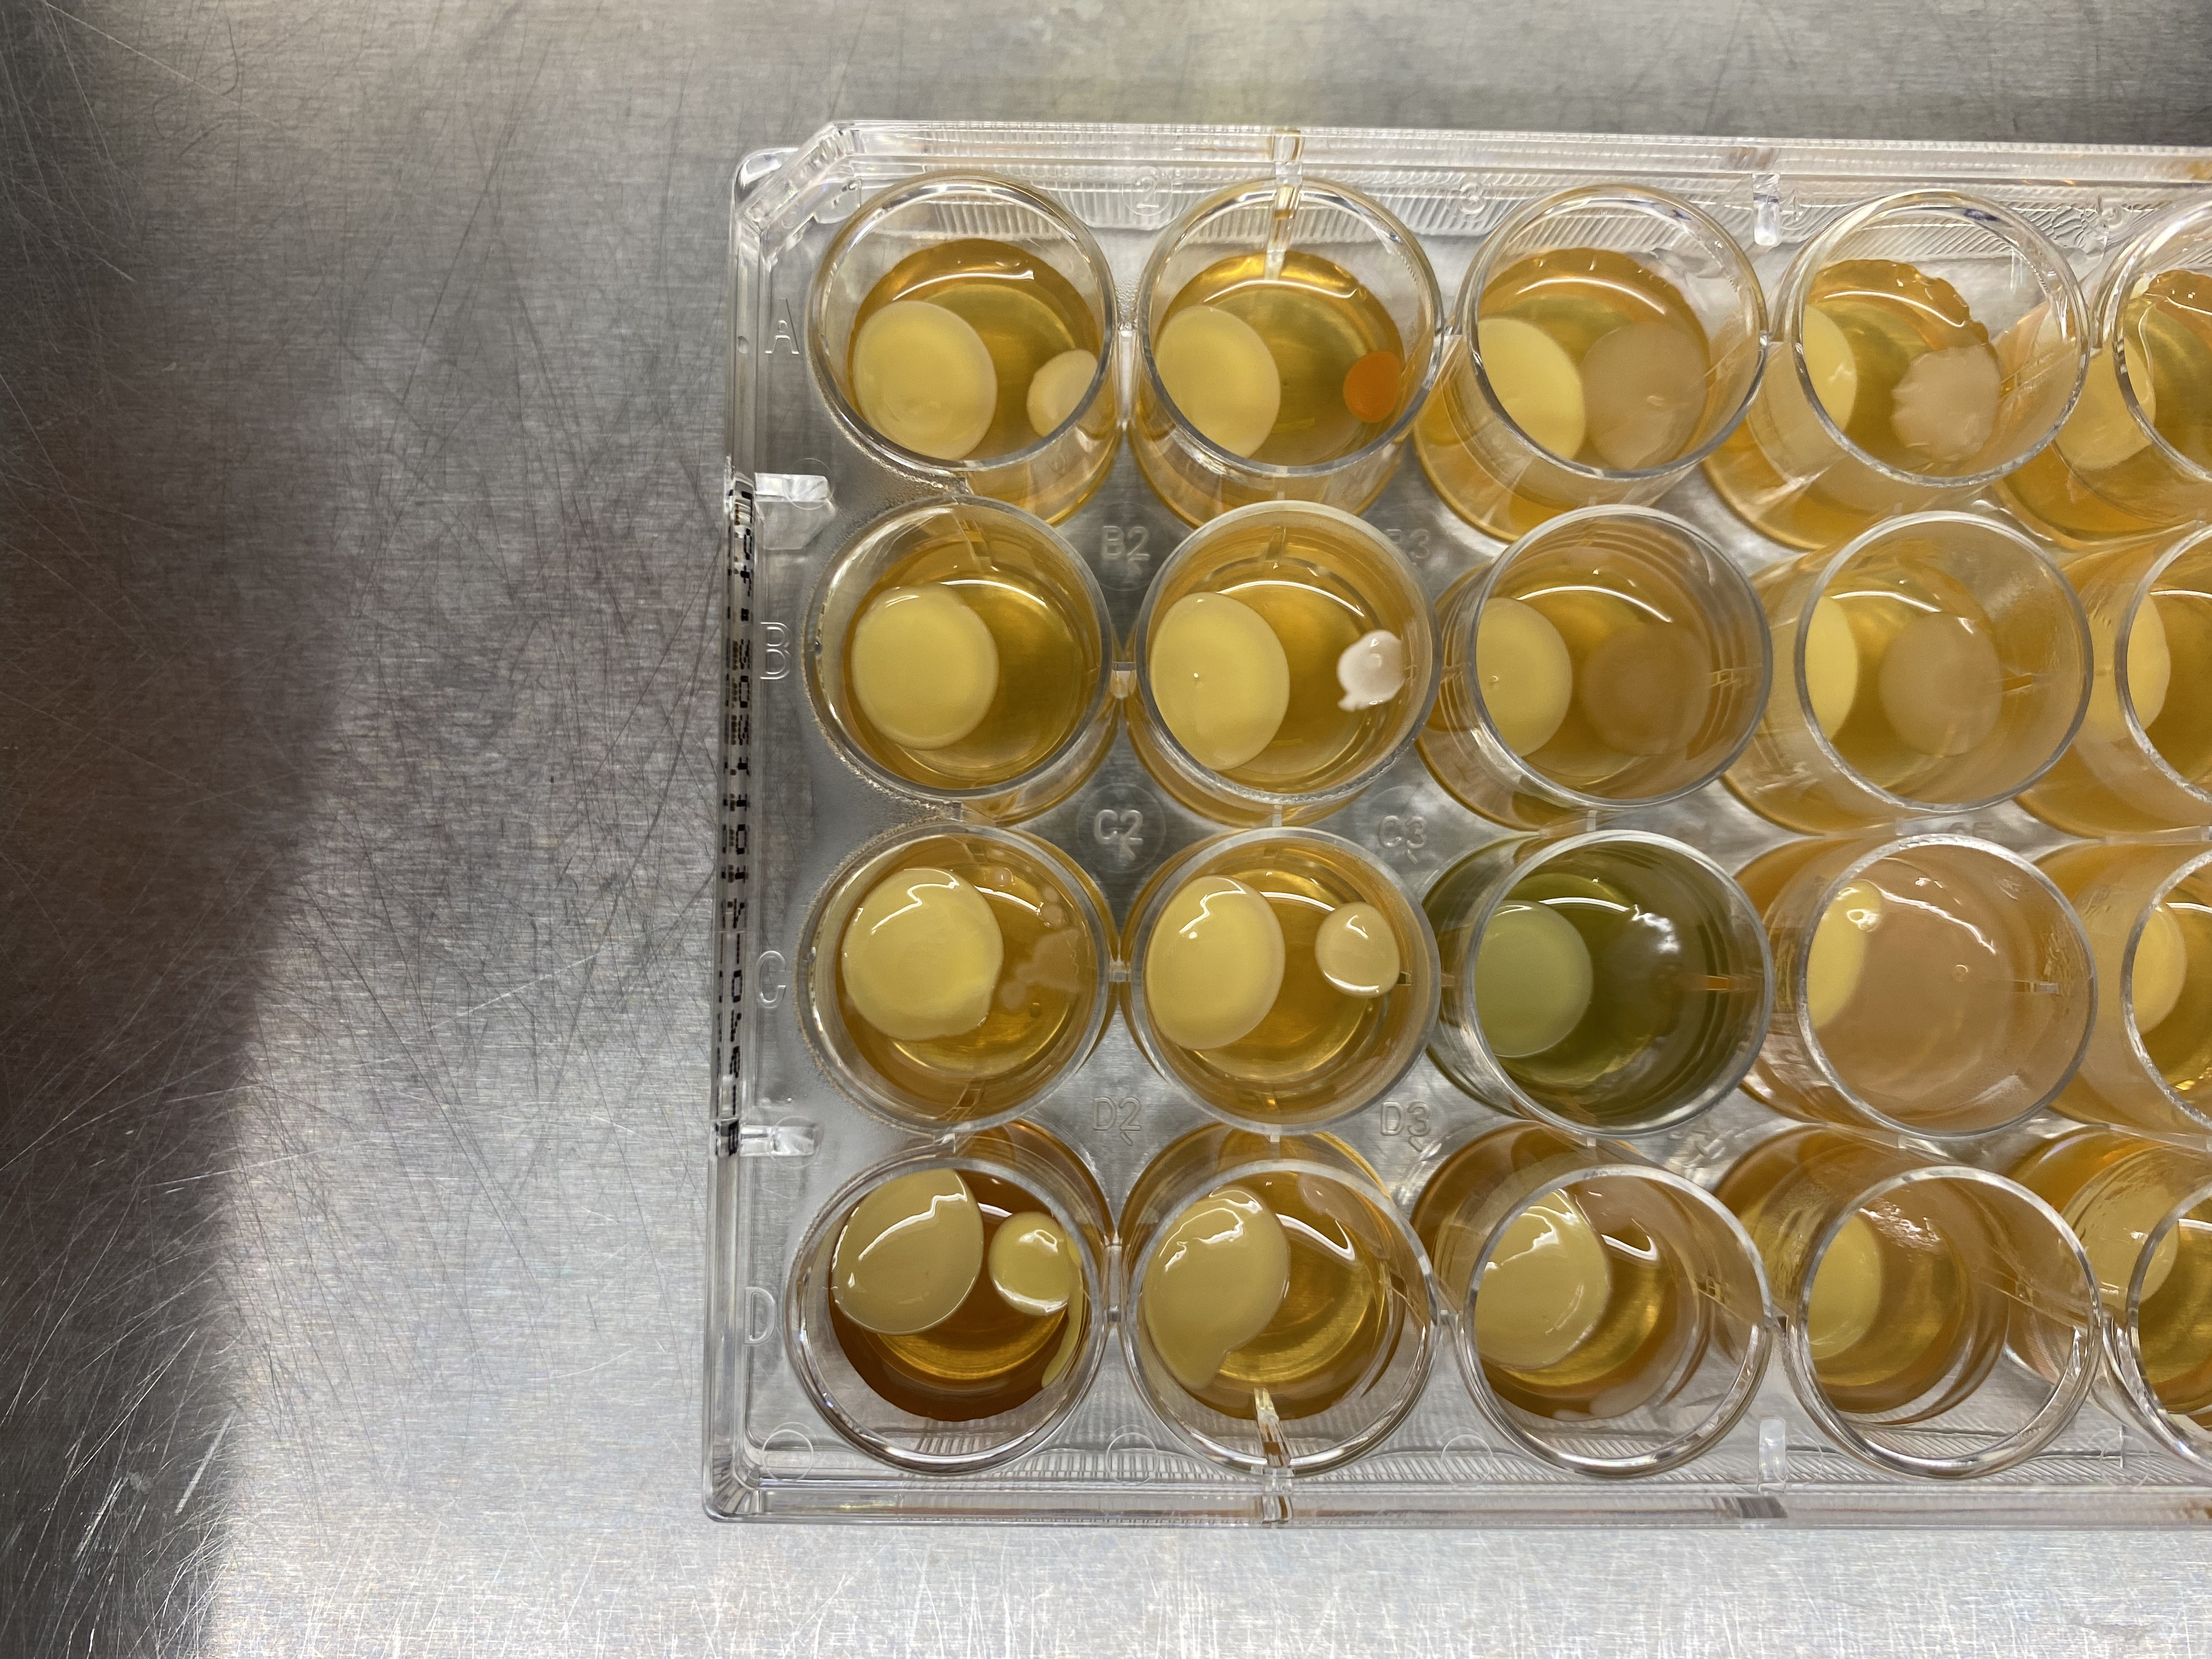
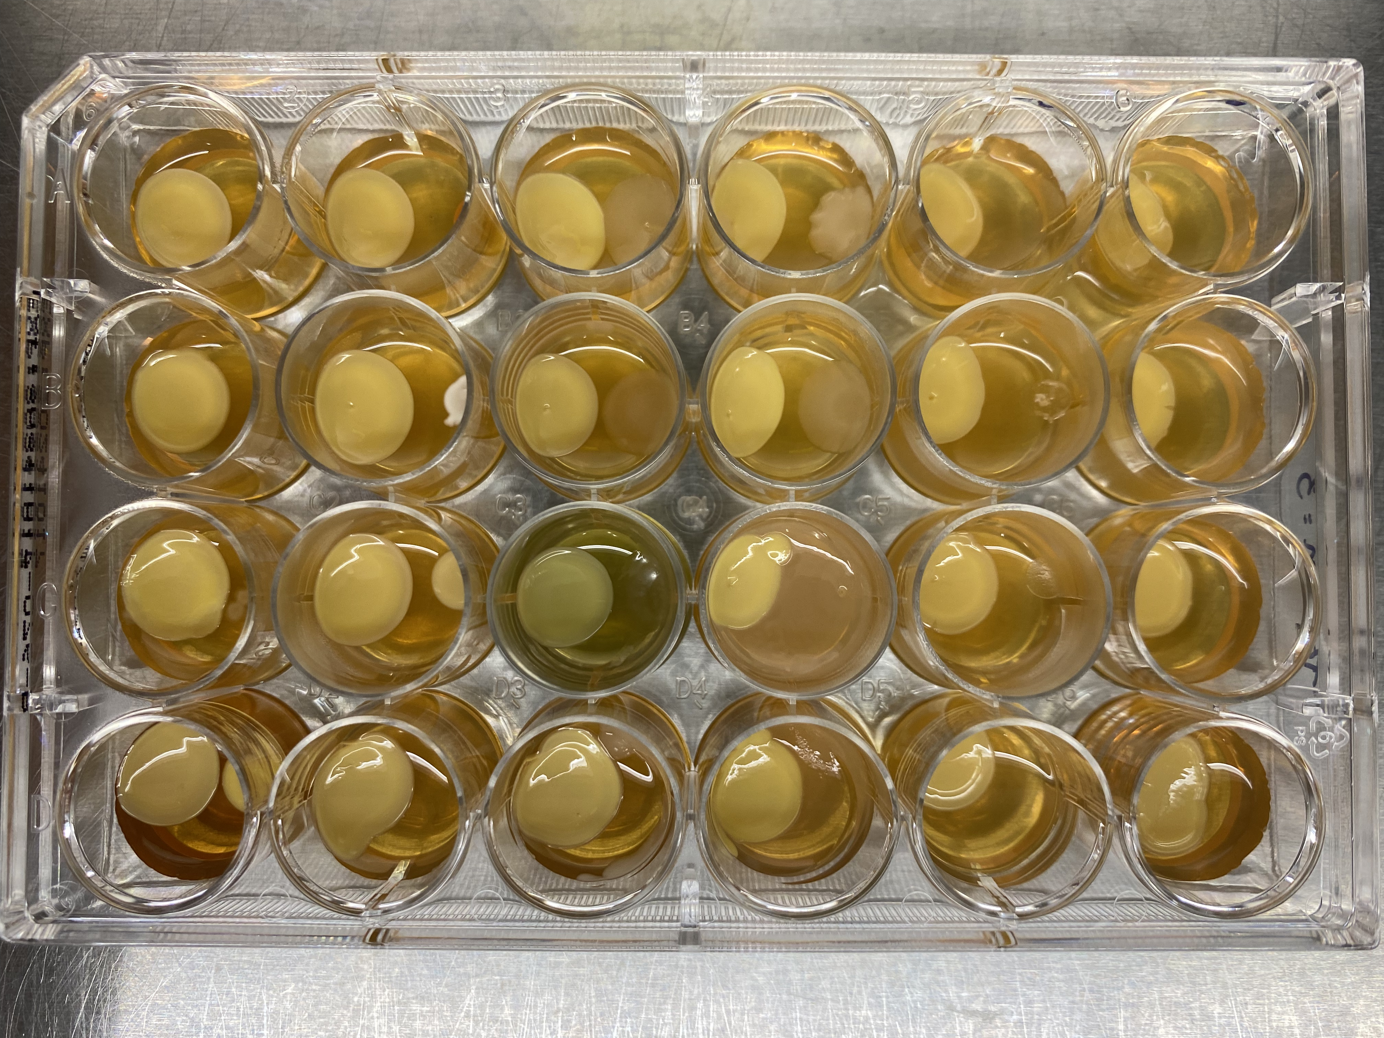
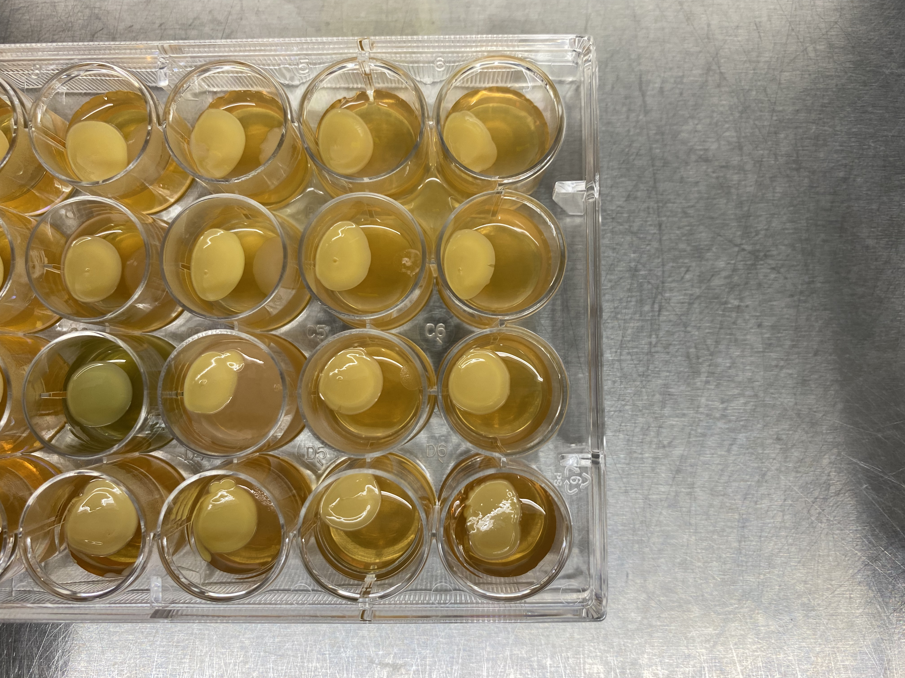
LK1337
Gram-negative
Fungi
Gram-positive

